Slide 1
Autonomous Vehicle Prototype
Group B7
Imad Chaar
Jad Al Jourdi
Maxim Speczyk
Stephanie Chinenye Okosa

Slide 2
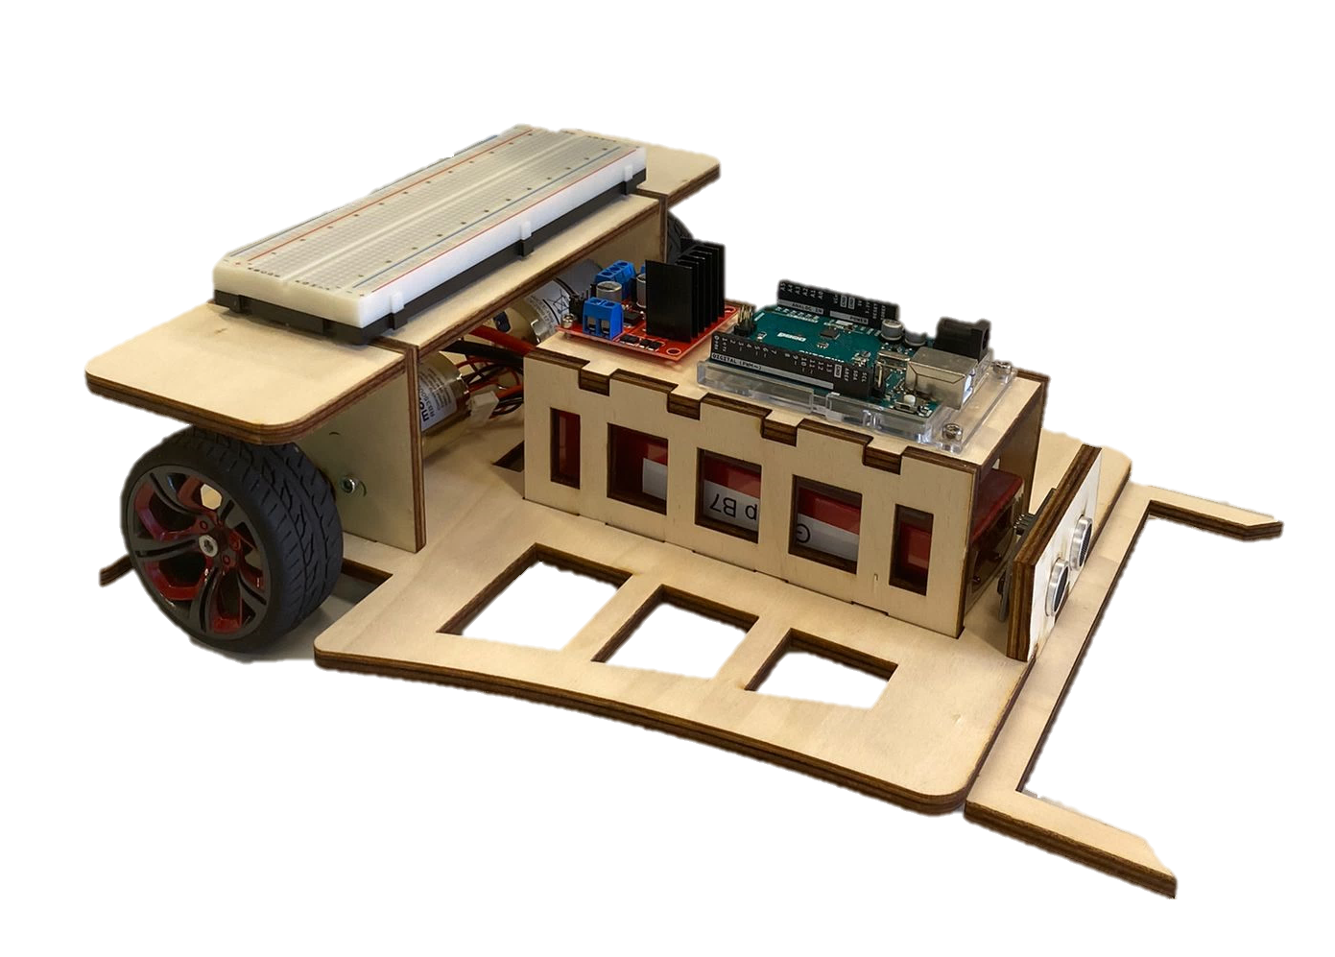
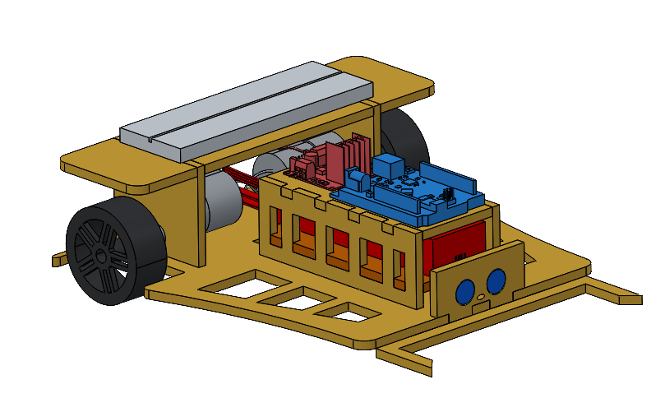
3D - Model
Prototype

Slide 3
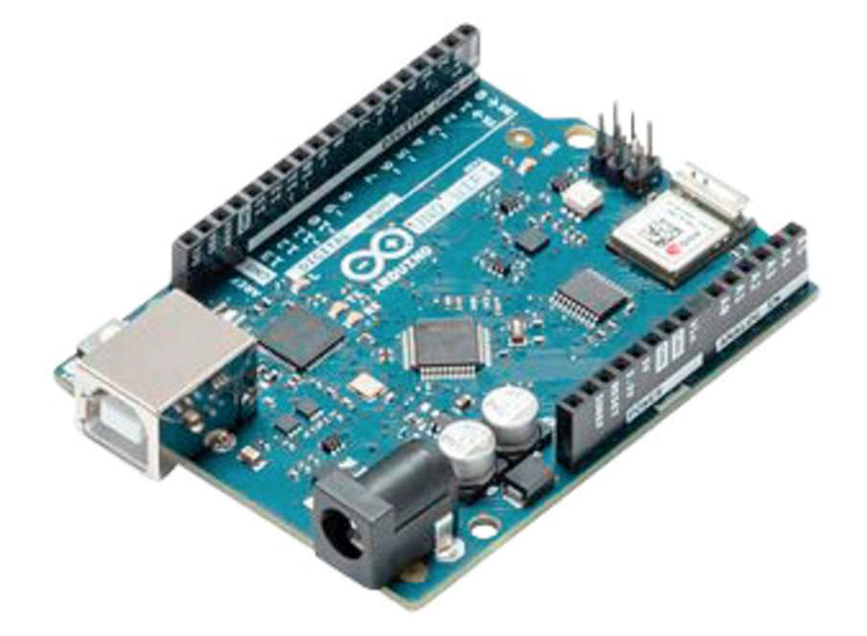
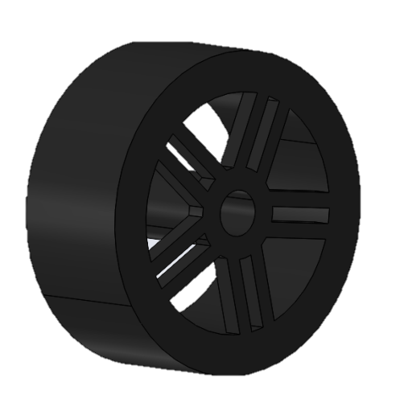
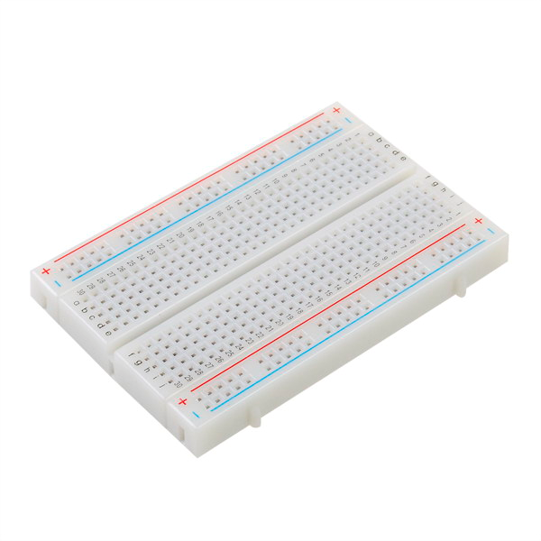
Hardware Components
Arduino Uno Wi-Fi R2
Motor Controller
Infrared Sensor
The autonomous vehicle prototype consists of various electronic components.
Motor
Front and Rear Wheels
Ultrasonic Sensor
Color Sensor
Breadboard
Battery

Slide 4
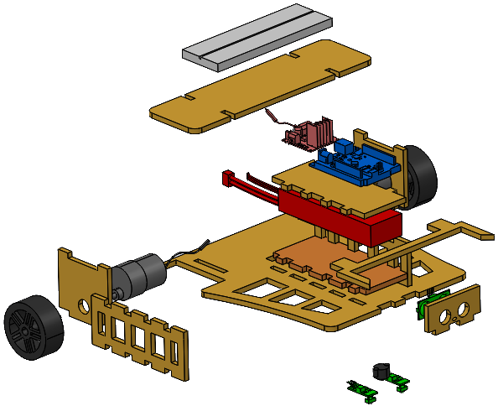
Design Functional
Assembled Part
Exploded Part

Slide 5
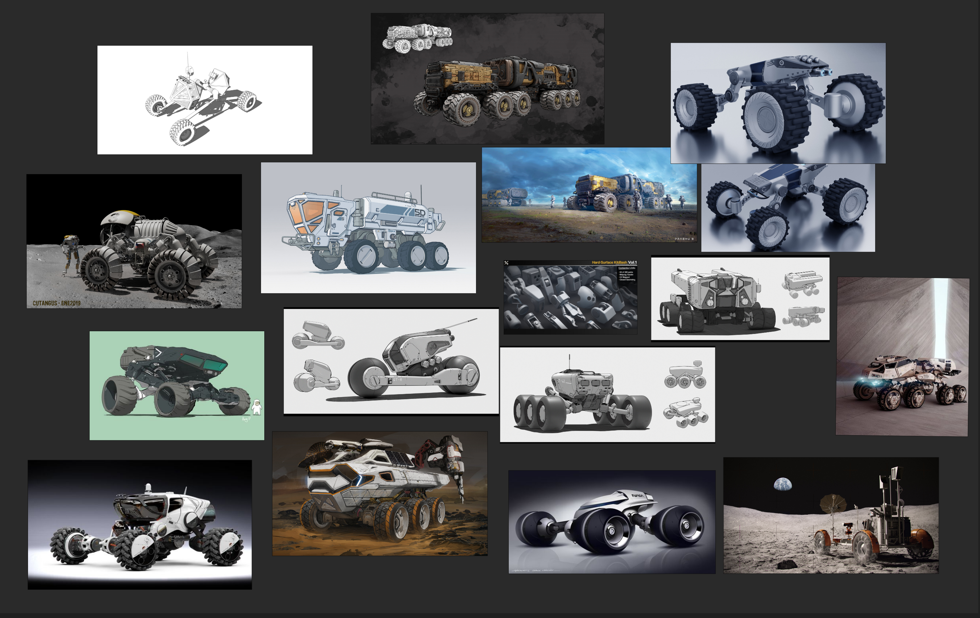
Design Style

Slide 6
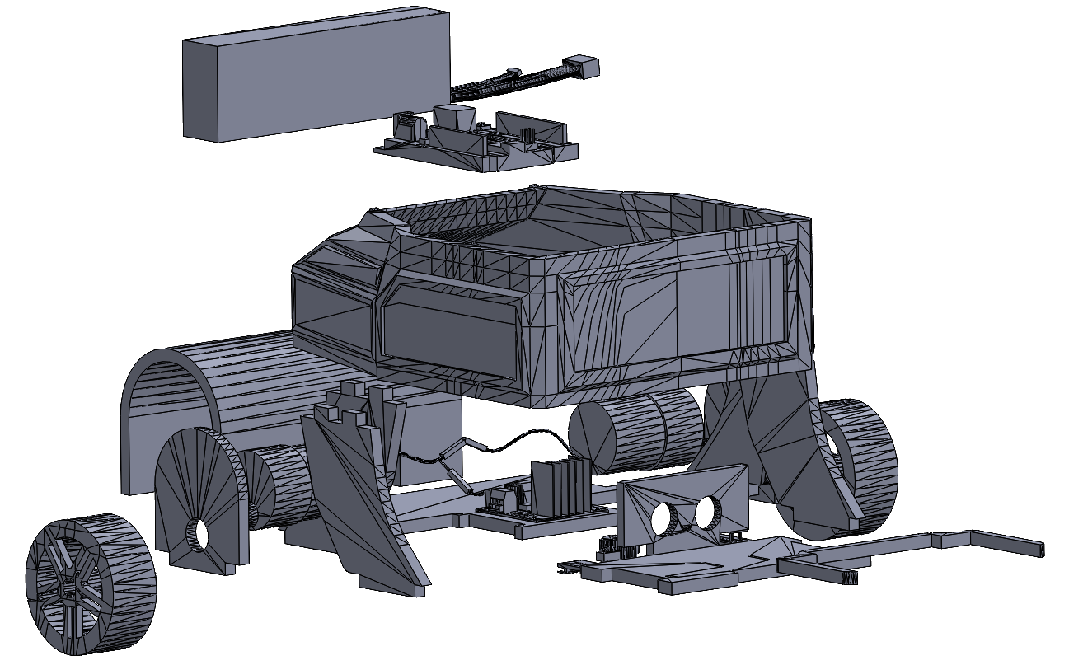
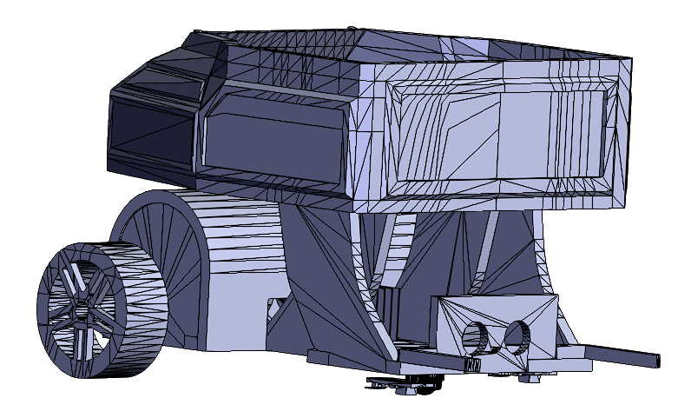
Design Style
Assembled Part
Exploded Part

Slide 7
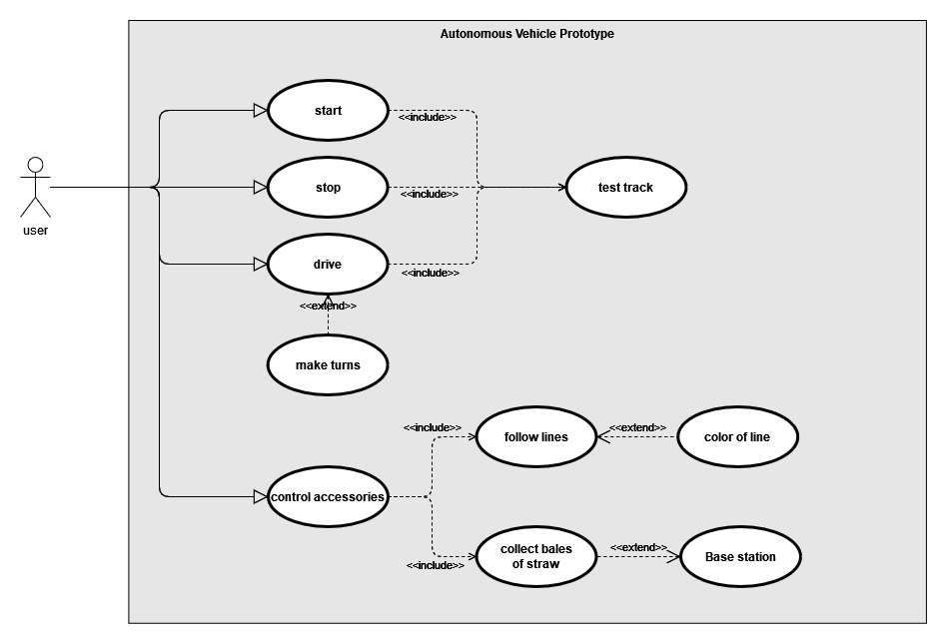
Use Case Diagram

Slide 8
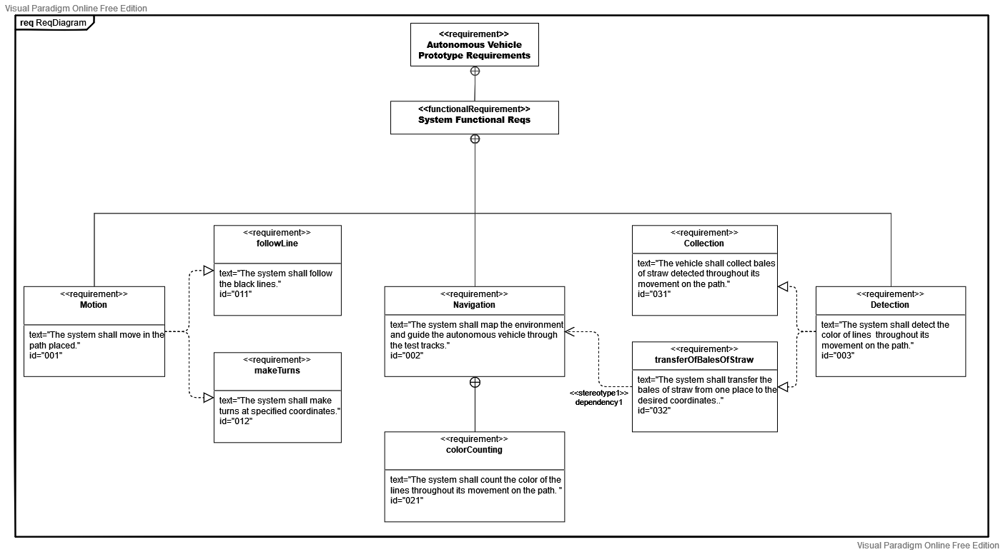
Functional Requirements

Slide 9
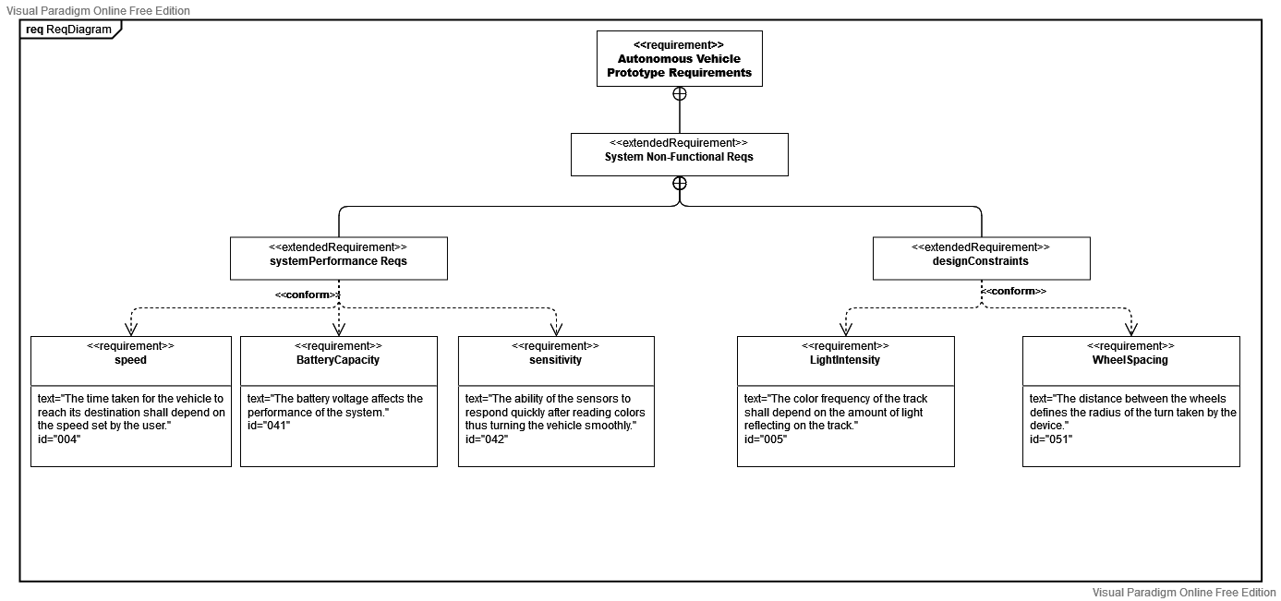
Non-Functional Requirements

Slide 10
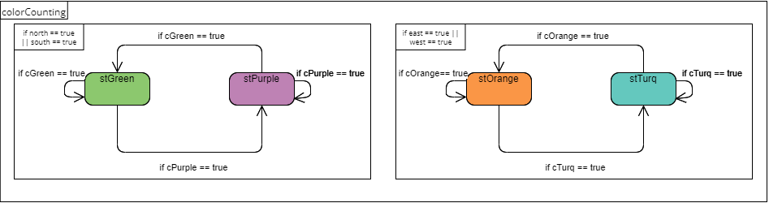
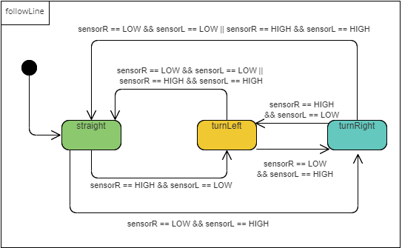
State Machine Diagram

Slide 11
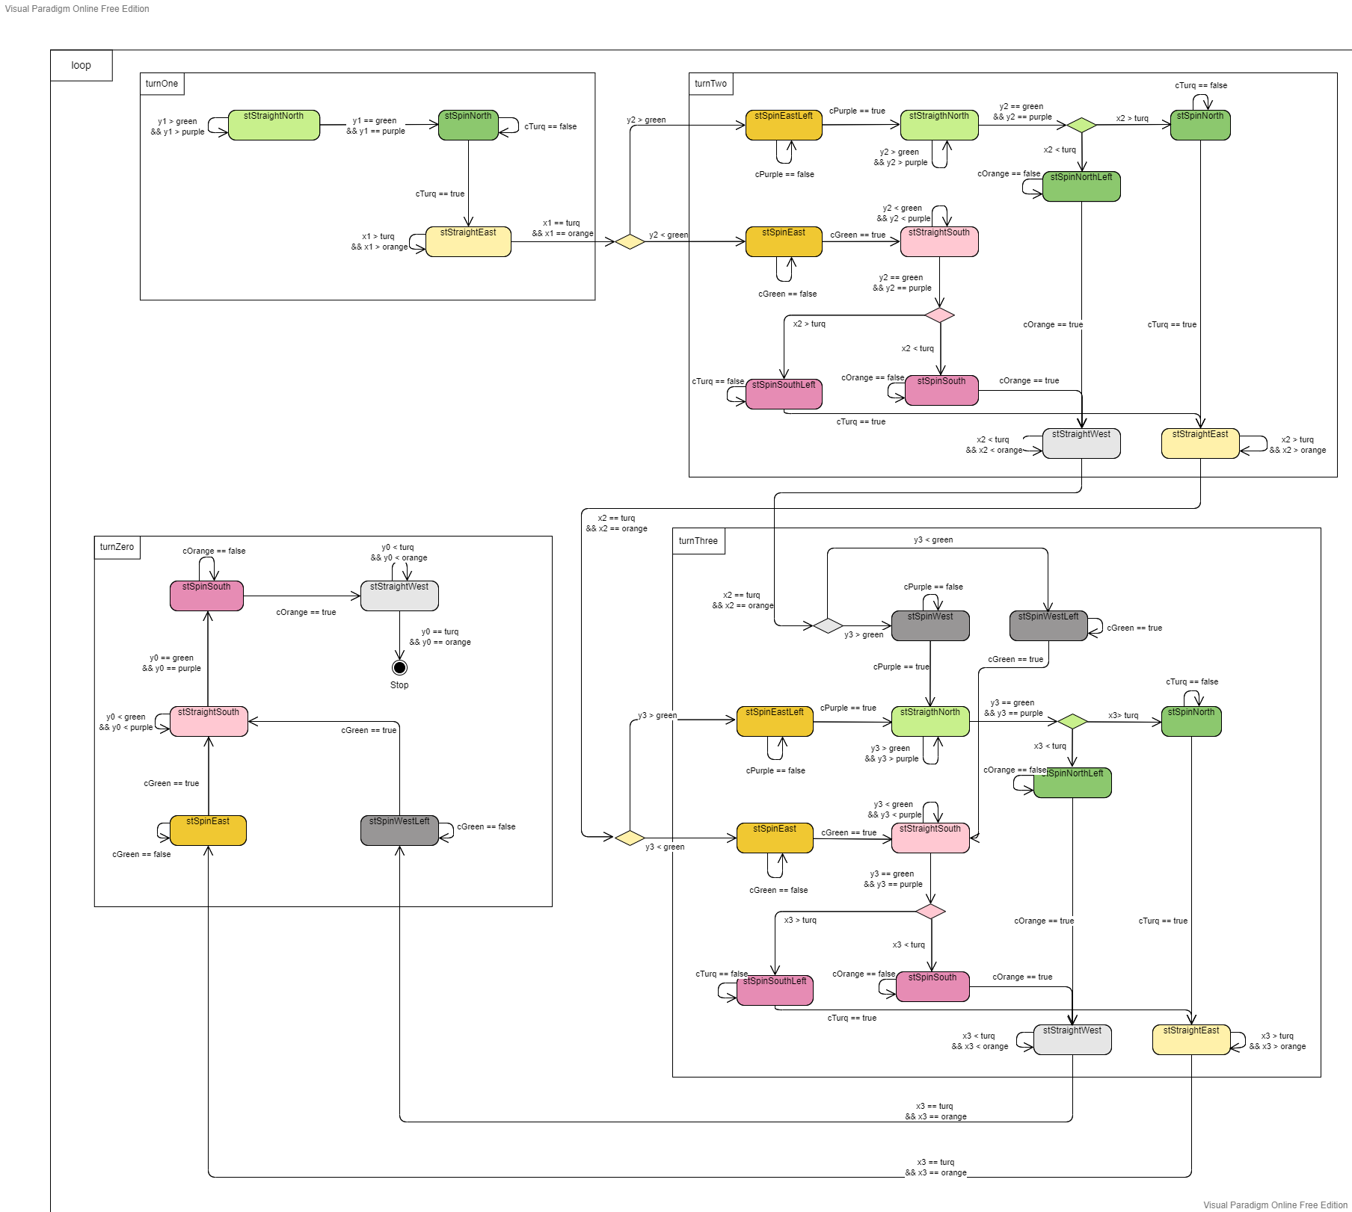
State Machine Diagram

Slide 12
State Machine Diagram

Slide 13
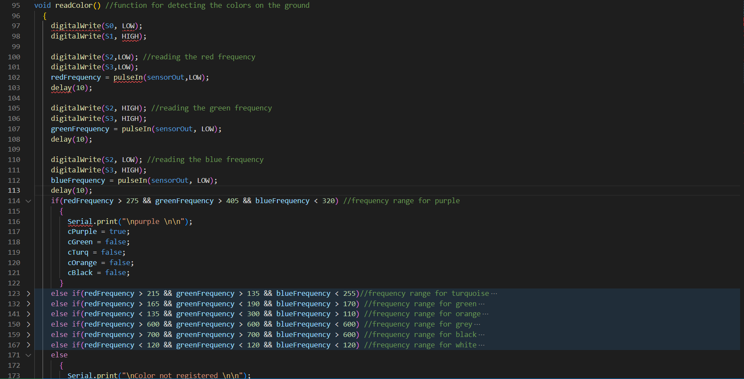
Read Color Function

Slide 14
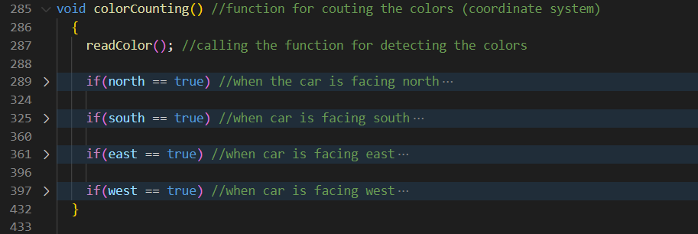
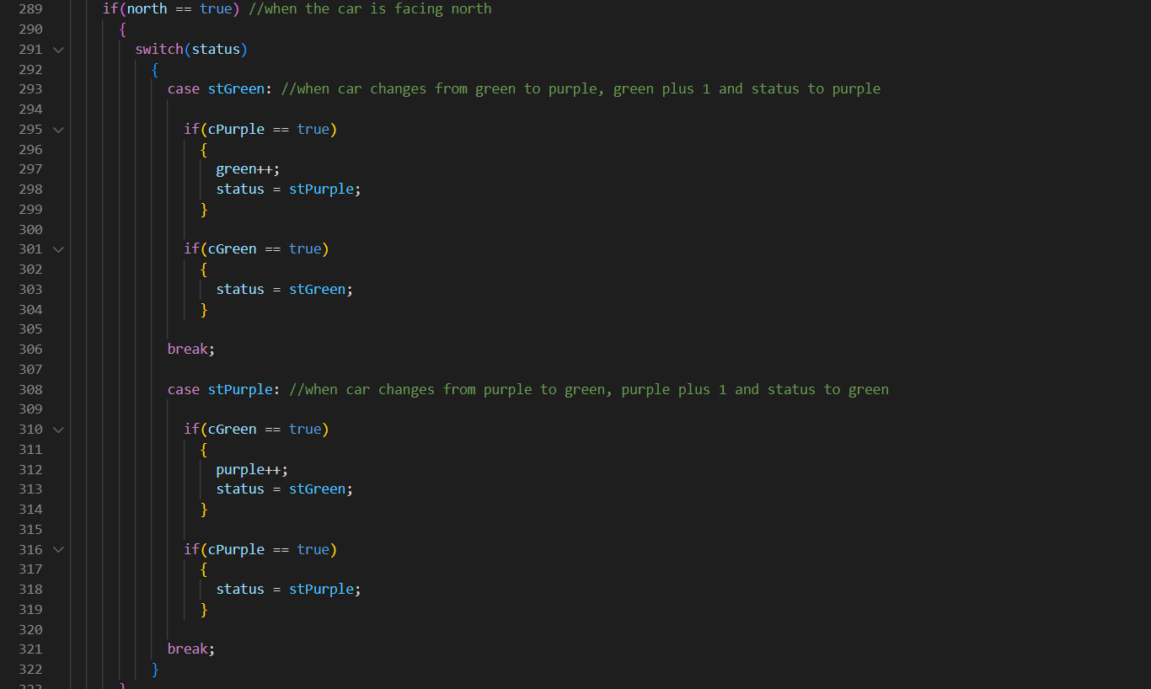
Color Counting Function

Slide 15
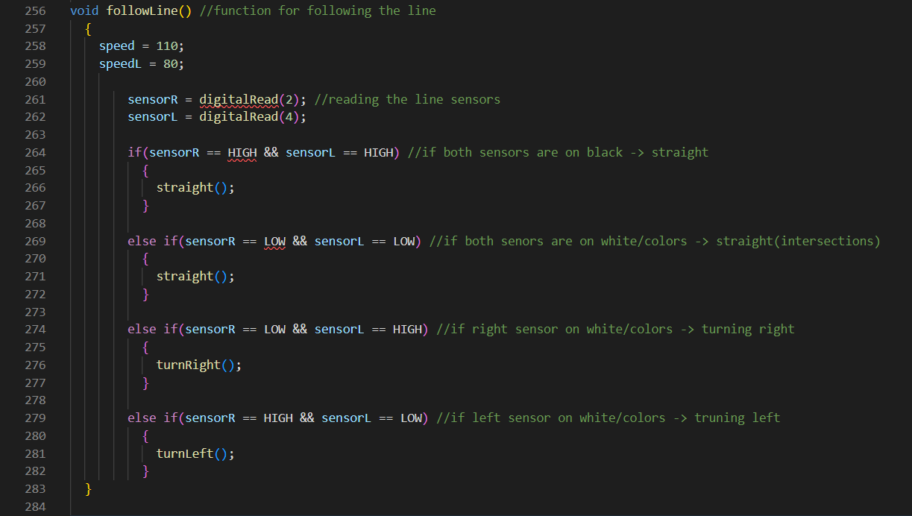
Follow Line Function

Slide 16
Thank you for your Attention

